Slide 1
Queues
EECE Department
ELC 303-B
Dr. Ahmed Khattab

Slide 2
Objectives
1. Understanding and applying the Queue ADT.
2. Implementing a Queue using an array and links.
3. Friendship and Inheritance in C++.
4. Implementing a Queue via list Inheritance.
5. Other Queue types: circular, priority, …

Slide 3
Queue Example
Real world examples
  Cars in line at a tool booth
  People waiting in line for a movie
Computer world examples
  Jobs waiting to be executed
  Jobs waiting to be printed
  Input buffers
    Characters waiting to be processed

Slide 4
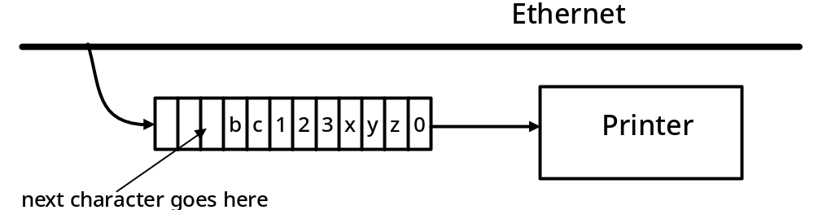
Printer Input Buffer Example

Slide 5
Common Queue Properties
Queues have the property that, the earlier an item enters a queue, the earlier it will leave the queue:
  First in, first out (FIFO)

Slide 6
Example
Items enter at rear and leave at front
Rear item is most recent addition to queue
Front item has waited
Longer than all other queue entries

Slide 7
Queues and lists
A queue is a restricted form of a list.
Additions to the queue must occur a the rear.
Deletions from the queue must occur at the front

Slide 8
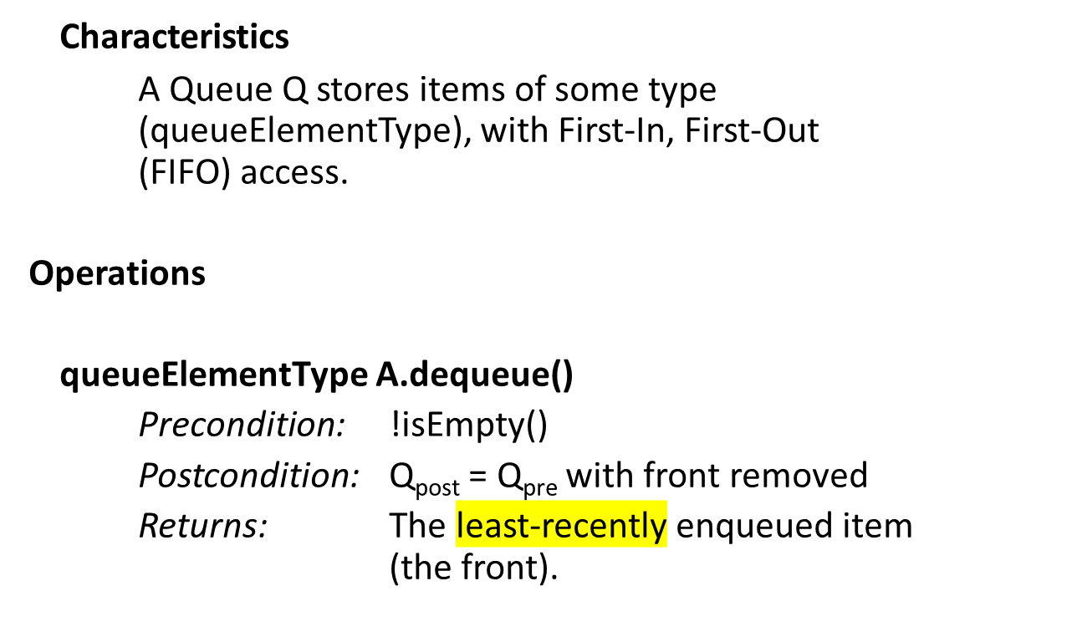
Queue ADT

Slide 9
Queue ADT operations (continued)
void Q.enqueue(queueElementType x)
Precondition: None
Postcondition: Q_{post} = Q_{pre} with x added to the rear.
queueElementType Q.front()
Precondition: !isEmpty()
Postcondition: None
Returns: The least-recently enqueued item
(the front).
bool Q.isEmpty()
Precondition: None
Postcondition: None
Returns: true if and only if Q is empty,
i.e., contains no data items.

Slide 10
Code Example
int main()
{
char c;
Queue < char > q;
Stack < char > s;

Slide 11
Code Example (continued)
// read characters until '.' found, adding each to Q and S.
while (1) {
cin >> c;
if (c == '.') break; // when '.' entered, leave the loop
q.enqueue(c);
s.push(c);
}
while (!q.isEmpty()) {
cout << "Q: " << q.dequeue() << '\t';
cout << "S: " << s.pop() << '\n';
}
return 0;
}

Slide 12
Sample Program Output
Q: a S: c
Q: b S: b
Q: c S: a
Queues preserve order while stacks reverse it.

Slide 13
Exercise 9-1
What is the output resulting from the following sequence, where q is an initially empty queue of int:
q.enqueue(1);
q.enqueue(2); // different than text
q.enqueue(3);
cout << q.front();
cout << q.dequeue();
cout << q.front();
if (q.isEmpty())
cout << “empty\n”;
else
cout << “not empty\n”;

Slide 14
Program Analysis
q.enqueue(1)
1
rear
front
q.enqueue(2)
2
1
rear
front
q.enqueue(3)
3
2
1
rear
front

Slide 15
Program output
cout << q.front();
3
2
1
1
rear
front
cout << q.dequeue();
3
2
1
1
rear
front
cout << q.front();
3
2
2
rear
front

Slide 16
Program Continued
if (q.isEmpty())
cout << “empty” << endl;
else
cout << “not empty” << endl;
3
2
not empty
rear
front

Slide 17
Array Implementation
Must keep track of front and rear
  more complicated than a stack

Slide 18
Rear and front
With data in a queue, implemented as an array, rear will normally be greater than front.
There are 3 special situations which must be addressed
1. Rear < front (empty queue)
2. Rear = front (one-entry queue)
3. Rear = array size (full queue)

Slide 19
Example: enqueueing
Empty queue
Single element
queue
Normal
queue
Front
Front
Front
Rear
Rear
Rear

Slide 20
Various Queue States
Normal
queue
Full
queue
dequeueing
Front
Front
Rear
Front
Rear
Rear

Slide 21
dequeueing
dequeueing
More
dequeueing
Single element
queue
Front
Front
Front
Rear
Rear
Rear

Slide 22
A problem
We cannot increase rear beyond
the limits of the array.
Therefore, this queue must be
regarded as full, even though there
are plenty of available memory cells.
One way to solve this might be to
Wait until the queue empties out and
Then reset it and start again.
In the computer processing job example
however, this would be unacceptable
since many jobs could arrive while the
queue is emptying out.
Single element
queue
Front
Rear

Slide 23
Another difficultly
Single element
queue
Is the queue
empty or full?
Our definition of
empty is rear < front,
so it is empty.
But, rear has reached
its limit. It cannot go
beyond the array,
Therefore,
the queue is full!
Front
Front
Rear
Rear

Slide 24
Solution: Wrapping Around
queue
Next enqueue
wraps around
Rear
Front
Front
Rear

Slide 25
The Circular Queue
Circular
queue
Rear
Rear
empty
empty
empty
empty
empty
empty
Front
empty
empty
Front

Slide 26
Author’s Example
Example:
  Queue is an array of 4 elements
  We wish to enqueue and dequeue multiple items

Slide 27
enqueue and dequeue operations
enqueue('a')
a
?
?
?
f
r
enqueue('b')
a
b
?
?
f
r
enqueue('c')
a
b
c
?
f
r
dequeue()
a
b
c
?
f
r
enqueue('d')
a
b
c
d
f
r
dequeue()
a
b
c
d
f
r
enqueue('e')
? ? ? ?

Slide 28
A Paradox
With an array, it is easy to run out of space in the queue to enqueue items and yet still have unused memory cells that can store data!
To get around this, we have to make it possible to ‘wrap around’
Both ‘rear’ and ‘front’ must be able to wrap around.

Slide 29
How to wrap around?
If rear + 1 > maxQueue -1 then set rear to 0
OR
rear = (rear+1) % maxQueue

Slide 30
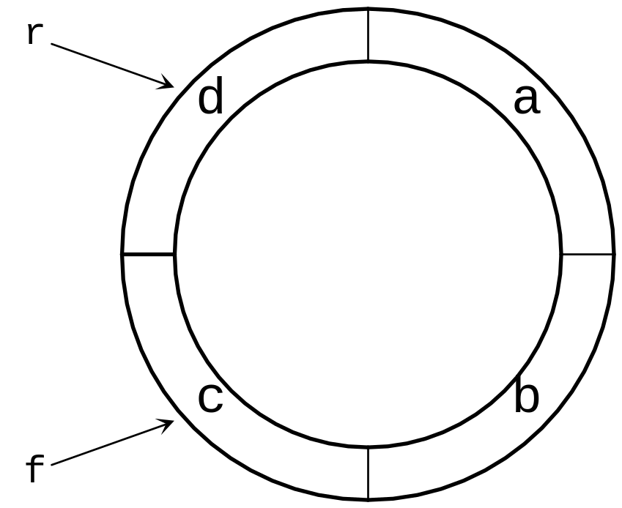
A Circular Queue

Slide 31
Main Issues (full and empty)
Wrapping around allows us to avoid an erroneous ‘full’
But, it means that we cannot use ‘rear < front’ as a test of whether the queue is empty because rear will become < front as soon as it wraps around

Slide 32
Rear and front
If there is one element in the queue then rear should be the same as front, therefore, rear must start < front.
You could check for an empty queue with something like: nextPos(rear) == front
But, when the queue is full it is also true that nextPos(rear) == front!

Slide 33
Queue implementation in which full and empty queues cannot be distinguished
r
f
f
f
r
f
r
a
a
d
a
c
b
c
b
r

Slide 34
Solution
To solve this dilemma we let the definition of empty be rear==front
Where front points to an empty cell
Then the test for empty is rear==front
And the test for full is nextPos(rear) == front

Slide 35
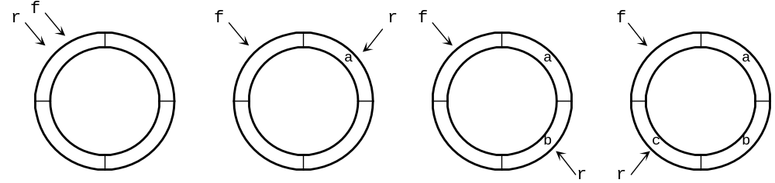
Corrected queue implementation demonstrated

Slide 36
Alternate queue implementations
(poor vs. good design)
r
f
f
f
r
f
r
a
a
d
a
c
b
c
b
r

Slide 37
Explanation using Conventional Arrays
Empty queue
((rear + 1) == front)
Wrapped
around
Full queue
((rear+1) == front)
Front
Rear
Rear
Rear
Front
Front

Slide 38
Solution
Empty queue
(rear == front)
Wrapped
around
Full queue
((rear+1) == front)
Front
Rear
Rear
Rear
Front
Front

Slide 39
Queue template
const int maxQueue = 200;
template < class queueElementType >
class Queue {
public:
Queue();
void enqueue(queueElementType e);
queueElementType dequeue();
queueElementType front();
bool isEmpty();
private:
int f; // marks the front of the queue
int r; // marks the rear of the queue
queueElementType elements[maxQueue];
};

Slide 40
NextPos( ), does the wrap around
int nextPos(int p)
{
if (p == maxQueue - 1) // at end of circle
return 0;
else
return p+1;
}

Slide 41
Constructor
template < class queueElementType >
Queue < queueElementType >::Queue()
{ // start both front and rear at 0
f = 0;
r = 0;
}

Slide 42
enqueue( )
template < class queueElementType >
void
Queue < queueElementType > :: enqueue(queueElementType e)
{ // add e to the rear of the queue, // advancing r to next position
assert(nextPos(r) != f);
r = nextPos(r);
elements[r] = e;
}

Slide 43
dequeue( )
template < class queueElementType >
queueElementType
Queue < queueElementType >::dequeue()
{
// advance front of queue, // return value of element at the front
assert(f != r);
f = nextPos(f);
return elements[f];
}

Slide 44
front( )
template < class queueElementType >
queueElementType
Queue < queueElementType >::front()
{
// return value of element at the front
assert(f != r);
return elements[nextPos(f)];
}

Slide 45
isEmpty( )
template < class queueElementType >
bool
Queue < queueElementType >::isEmpty()
{
// return true if the queue is empty, that is,
// if front is the same as rear
return bool(f == r);
}

Slide 46
Dynamic Queues
The advantages of linked list implementation are
  The size is limited only by the pool of available nodes (the heap)
  There is no need to wrap around anything.
Advantage of using the heap
  No need for program to check for a full queue (this is handled by the ‘new’ function.

Slide 47
Header for Queue as Dynamic List
template < class queueElementType >
class Queue {
public:
Queue();
void enqueue(queueElementType e);
queueElementType dequeue();
queueElementType front();
bool isEmpty();

Slide 48
Private section
private:
struct Node;
typedef Node * nodePtr;
struct Node {
queueElementType data;
nodePtr next;
};
nodePtr f;
nodePtr r;
};

Slide 49
Implementation file, constructor
template < class queueElementType >
Queue < queueElementType >::Queue()
{
// set both front and rear to null pointers
f = NULL;
r = NULL;
}

Slide 50
enqueue( )
template < class queueElementType >
void Queue < queueElementType > ::enqueue(queueElementType e)
{// create a new node, insert it at the rear of the queue
nodePtr n=new Node;
assert(n);
n->next = NULL;
n->data = e;
if (f != NULL) { // existing queue is not empty
r->next = n; // add new element to end of list
r = n;
} else {// adding first item in the queue
f = n; // so front, rear must be same node
r = n;
}
}

Slide 51
A Single-Element Queue
Front
data
Rear
A single element queue
Front == rear

Slide 52
enqueueing
Rear
n
Rear
n
Rear
n

Slide 53
dequeue( )
template < class queueElementType >
queueElementType
Queue < queueElementType >::dequeue()
{ assert(f); // make sure queue is not empty
nodePtr n=f;
queueElementType frontElement = f->data;
f = f->next;
delete n;
if (f == NULL) // we're deleting last node
r = NULL;
return frontElement;
}

Slide 54
dequeueing
Front
Rear
n
Front
Rear
Front
Rear

Slide 55
front ( )
template < class queueElementType >
queueElementType
Queue < queueElementType >::front()
{
assert(f);
return f->data;
}

Slide 56
isEmpty( )
template < class queueElementType >
bool
Queue < queueElementType >::isEmpty()
{
// true if the queue is empty -- when f is a null pointer
return bool(f == NULL);
}

Slide 57
Friendship and Inheritance
Friends
  Friends are functions or classes declared with the friend keyword.
  Friends of class A have access to the protected and private members of class A.
  Friendships are not transitive: The friend of a friend is not considered to be a friend unless explicitly specified.
Notes:
class Square { friend class Rectangle;
class Rectangle is a friend of class Square allowing Rectangle's member functions to access private and protected members of Square.

Slide 58
Friendship and Inheritance
Inheritance
  Inheritance is a mechanism of reusing and extending existing classes without modifying them.
  Inheritance is almost like embedding an object into a class.
  Suppose that you declare an object x of class A in the class definition of B. As a result, class B will have access to all the public data members and member functions of class A.
  However, in class B, you have to access the data members and member functions of class A through object x.
Notes:
Can override a function

Slide 59
Inheritance
#include <iostream>
using namespace std ;
class A {
int data ;
public :
void f ( int arg ) { data = arg ; }
int g ( ) { return data ; }
} ;
class B {
public :
A x ;
} ;
int main ( ) {
B obj ;
obj . x . f (20) ;
cout << obj . x . g ( ) << endl ;
// cout << obj . g ( ) << endl ;
}

Slide 60
Inheritance
Inheritance mechanism lets you use a statement like obj.g() in the above example. In order for that statement to be legal, g() must be a member function of class B
#include <iostream>
using namespace std ;
class A {
int data ;
public :
void f ( int arg ) { data = arg ; }
int g ( ) { return data ; }
} ;
class B : public A { } ;
int main ( ) {
B obj ;
obj . f (20) ;
cout << obj . g ( ) << endl ;
}

Slide 61
Inheritance
Syntax:
class DerivedClassName : access-level BaseClassName
where
  access-level specifies the type of derivation
    private by default, or
    public
Any class can serve as a base class
  Thus a derived class can also be a base class

Slide 62
Notes on Inheritance
Class A is a base class of class B. The names and definitions of the members of class A are included in the definition of class B.
Class B inherits the members of class A.
Class B is derived from class A.
Class B contains a sub-object of type A.
You can also add new data members and member functions to the derived class.
You can modify the implementation of existing member functions or data by overriding base class member functions or data in the newly derived class.

Slide 63
Notes on Inheritance
A derived class inherits every member of a base class except
  Its constructor and its destructor.
    However, the default constructor (i.e., its constructor with no parameters) and destructor of the base class are always called when a new object of a derived class is created or destroyed.
    The base default constructor can be overridden.
  Its operator=() members
  Its friends

Slide 64
Queue Implementation via List Inheritance
#ifndef QUEUE_H
#define QUEUE_H
#include "List. h" // List class definition
template < class QUEUETYPE >
class Queue : private List< QUEUETYPE >
{
public :
// enqueue calls list member function insertAtBack
void enqueue ( const QUEUETYPE &data )
{
insertAtBack ( data ) ;
} // end function enqueue

Slide 65
Queue Implementation via List Inheritance
// dequeue calls List member function removeFromFront
bool dequeue ( QUEUETYPE &data )
{
return removeFromFront ( data ) ;
} // end function dequeue
// isQueueEmpty calls List member function isEmpty
bool isQueueEmpty ( ) const
{
return isEmpty ( ) ;
} // end function isQueueEmpty
// printQueue call s List member function print
void printQueue ( )
{
print ( ) ;
} // end function printQueue
} ; // end class Queue
#endif

Slide 66
Priority Queues
Priority queues are a special type of queues in which queue elements are processed in order of importance/priority
The priority queues appears in different contexts
  packets with different priority
  patients at emergency section
Implementation Approaches
  Unsorted list
    Adv: simple insert
    Disadv: search before dequeue
  Linked sorted list
    Adv: simple dequeue (always get the first element)
    Disadv: O(N) enqueue as we need to decide where to insert the received object

